Slide 1
Laser Safety for Researchers
Radiation Safety Office

Slide 2
Table of Contents
Fundamentals of Laser Operation
Bioeffects of Laser Radiation
Significance of Reflection
Non-beam Hazards
Laser System Classifications
Control Measures
Employee Responsibilities

Slide 3
Fundamentals of Laser Operation

Slide 4
Overview
The word laser is an acronym derived from the phrase “Light Amplification by Stimulated Emission of Radiation”
A laser-equipped device can generate a high-intensity light that is:
Monochromatic
Unidirectional
Parallel
These unique characteristics make lasers useful for commercial, medical and research applications

Slide 5
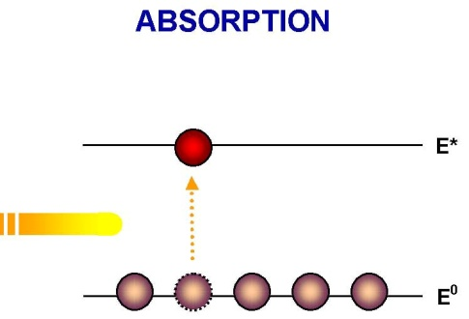
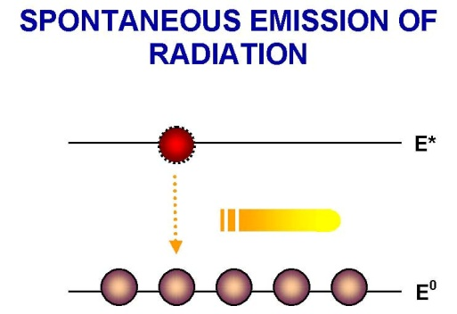
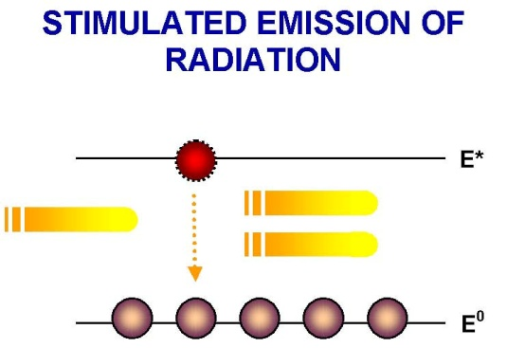
Laser Production
Atoms at their resting energy state, or ground state (E0), can be excited to a higher energy state (E*) after absorbing energy
If the excited state is unstable it will spontaneously return to the ground state and liberate a photon of energy (light)
If the liberated photon encounters another identical atom in an excited state, it can stimulate the emission of a second photon, thereby doubling the emitted light

Slide 6
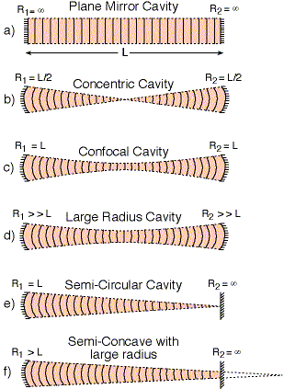
Laser Components
Different active media emit different energies or wavelengths of light. Medium can be either:
Solids
Liquids
Gases
An optical cavity: resonator contains active medium; at each end of the resonator parallel mirrors are placed facing each other. The front of the output mirror is designed to be partially reflective. The rear mirror reflects some of the energy
An energizing source: spontaneous emission of photons occurs when active medium is pumped with sufficient energy. Some of these photons are reflected back and forth between the 2 mirrors

Slide 7
Laser Beam

Slide 8
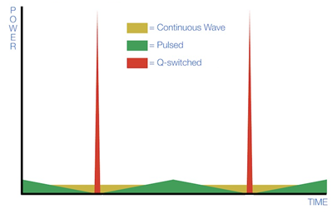
Wave Types
Continuous Wave [CW] lasers deliver a continuous beam output with relatively constant intensity. This is accomplished by constantly pumping energy into the active medium
Pulsed lasers deliver a high intensity output in short pulses (milliseconds) without the use of a shutter. Emissions are produced when the pump is modulated to create discrete, typically broad, pulses
Q-Switched lasers deliver very short pulses (nanoseconds) with extremely high intensity. This is accomplished using a special technique that involves building a large population inversion before beginning the stimulated emission process

Slide 9
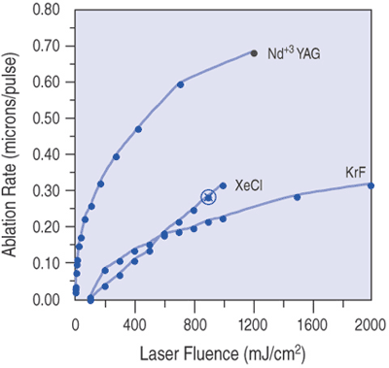
Laser Beam Properties:
Intensity: Laser beam intensity is defined by either its irradiance (the energy delivered per unit area of irradiated tissue) or the power density (the rate at which energy is delivered per unit area of irradiated tissue)
Fluence: The total amount of energy delivered to the tissue by the laser
Wavelength: The effect of lasers on the eyes and skin depend on the wavelength of the laser output

Slide 10
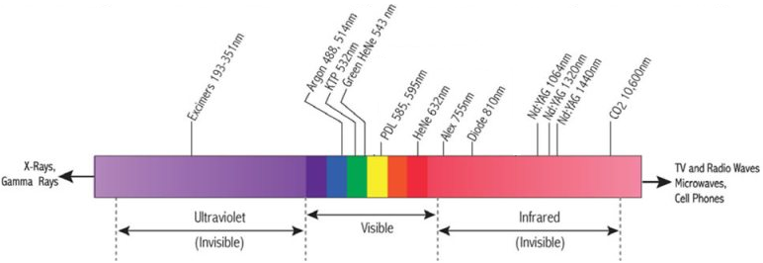
Laser Wavelengths

Slide 11
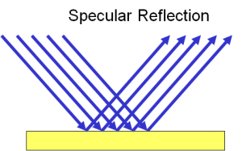
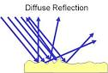
Reflection
Specular reflection is the mirror-like reflection of light from a smooth surface in which light from a single incoming direction is reflected into a single outgoing direction. Such behavior is described by the law of reflection
Diffuse reflection is the uniform reflection of light from a matte (rough) surface with no directional dependence. Diffuse reflections originate from a combination of internal scattering, i.e. the light is absorbed and then re-emitted, and external scattering from the rough surface of the object. The rougher an object’s surface is, the more diffuse reflections it will have and the less specular reflections it will have

Slide 12
Laser Classification

Slide 13
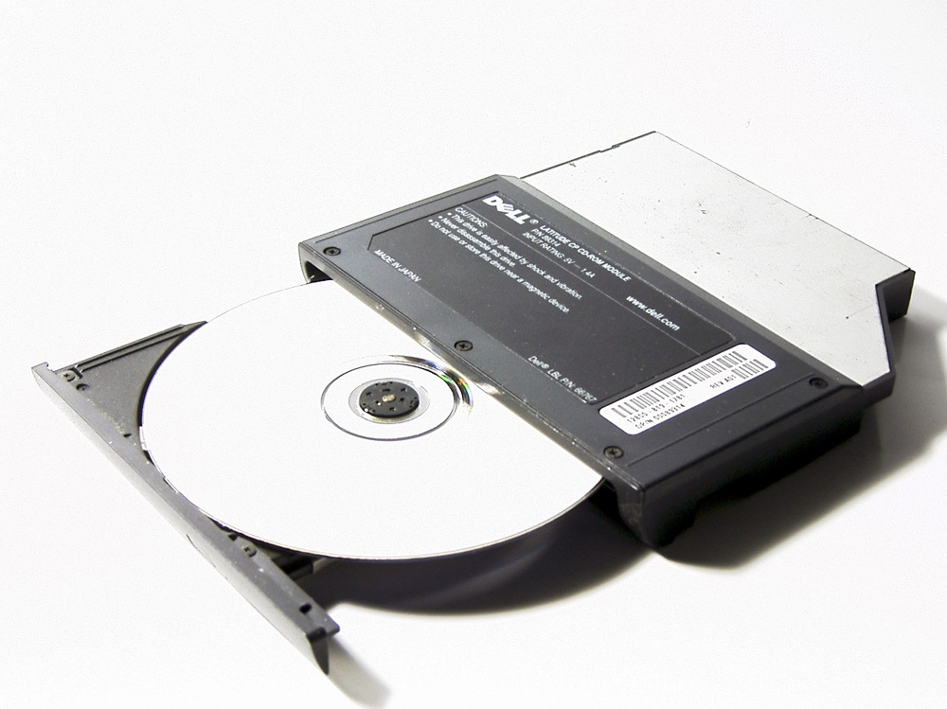
Class 1 Lasers
Class 1: Incapable of producing damaging radiation levels during normal operation
Class1M: A class 1 laser that may be capable of producing damaging radiation levels if viewed with an optical magnifying instrument such as eye-loupe (diverging beam) or a telescope (collimated beam)
Eye glasses and contact lenses are not considered optical or viewing aids
Class 1 and 1M lasers are exempt from any control measures or other forms of surveillance, other than preventing potentially hazardous optically aided viewing
Most CD drives use class 1 lasers

Slide 14
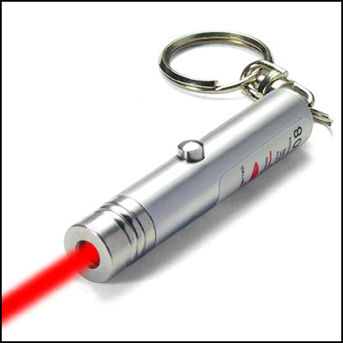
Class 2 Lasers
Class 2: Visible light laser (between 400-700 nm) that is incapable of producing damaging radiation levels due to the aversion response (blink reflex) of the human eye which limits the ocular exposure time to 0.25 seconds
The aversion response is a self-defense response that works by closure of the eyelid, eye movement, pupillary contraction or movement of the head to avoid a noxious or bright light stimulation. Never try, or urge someone to try, to override the aversion response while firing a laser
Class 2M: A class 2 laser that may produce damaging levels of radiation if viewed with an optical magnifying instrument such as eye-loupe (diverging beam) or a telescope (collimated beam)
Many laser pointers are class 2

Slide 15
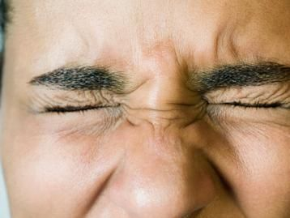
Aversion Response
The aversion response is a self-defense response that works by closure of the eyelid, eye movement, pupillary contraction or movement of the head to avoid a noxious or bright light stimulation
NOTE: Never try, or urge someone to try, to override the aversion response while firing a laser

Slide 16
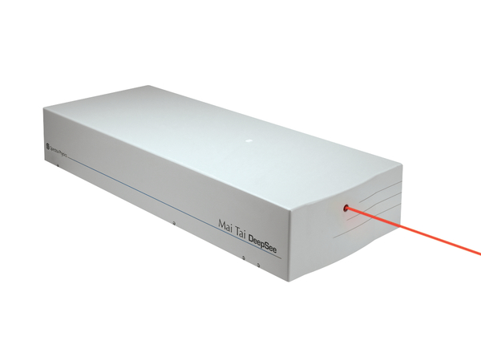
Class 3 Lasers
Class 3R: considered safe if handled carefully, with restricted beam viewing. The MPE can be exceeded with a low risk of injury
Class 3B: May be hazardous under direct and specular reflection viewing conditions, but is normally not a diffuse or fire hazard
This “Mai Tai DeepSee” laser device is an example of a class 3 laser

Slide 17
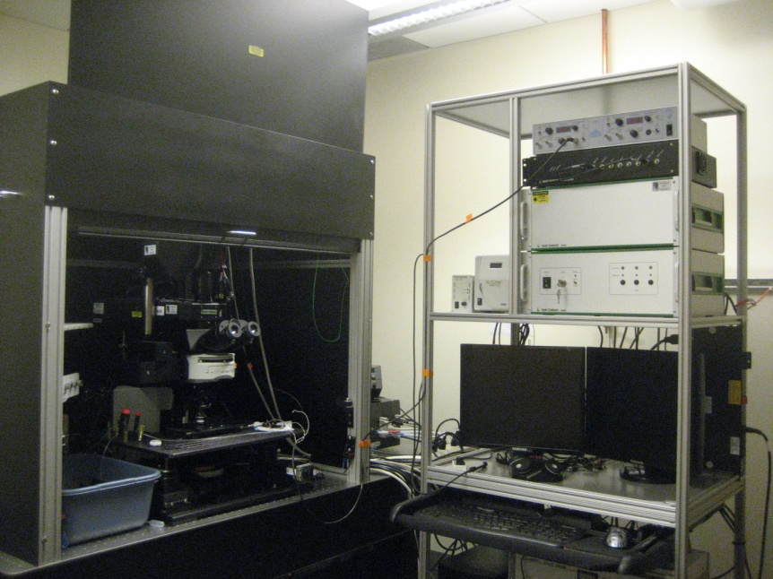
Class 4 Lasers
Class 4: Direct, diffuse or indirect beam viewing can burn the skin or cause devastating and permanent eye damage. These lasers may also ignite combustible materials, and thus represent a fire risk. In addition these lasers may also produce laser generated air contaminants (LGACs) and hazardous plasma radiation
NOTE: Some effectively class 1 laser devices actually contain higher class 3B or 4 lasers embedded inside, such as flow cytometers, for users of such devices laser safety training is required
This “Praire Laser Microscope System” uses class 4 lasers

Slide 18
Control Measures

Slide 19
General
The purpose of control measures is to reduce the possibility of human exposure to hazardous laser radiation and non-beam hazards
Control measures shall be devised to reduce the possibility of exposure of the eye and skin to hazardous levels of laser radiation, and other hazards associated with laser devices during operation and maintenance
No one shall be exposed to laser radiation levels exceeding the applicable MPEs under any reasonably foreseeable conditions of operation

Slide 20


Manufacturer Control Measures
Federal law in the United States requires that:
All laser products comply with the Federal Laser Product Performance Standard (FLPPS)
All laser products are certified by the manufacturers
All laser components, component subsystems, or repair parts, must be registered with the FDA Center for Devices and Radiological Health (CDRH)

Slide 21
User Control Measures
User controls measures are implemented by the user in order to ensure the safety of the laser:
Operation
Maintenance
Service
Examples of user control measures include:
Using the minimum laser radiation needed for the application
Selecting a beam height of the laser equipment other than the nominal position of the eye of a person in the standing or seated position

Slide 22
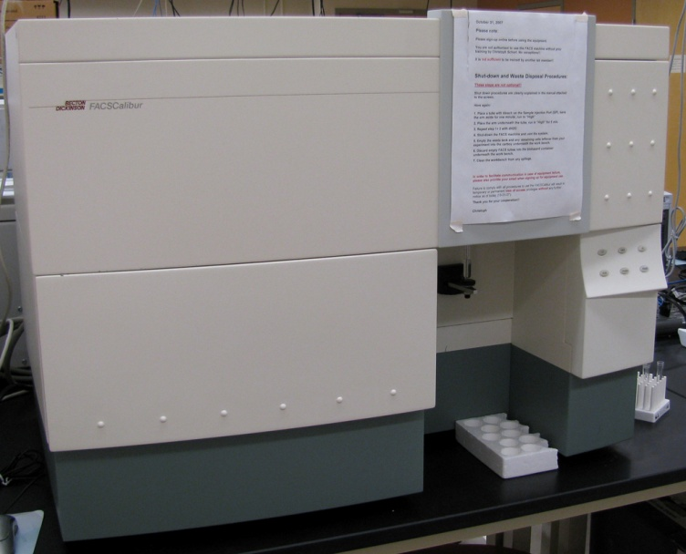
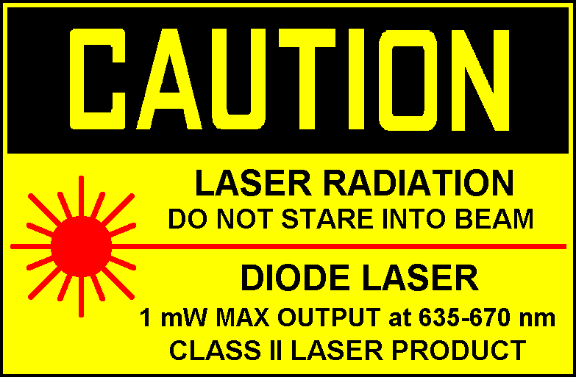
Engineering Controls
Service access panels for all classes are only intended to be removed by service personnel and must be either interlocked or require a tool for removal and must have an appropriate label
Interlocks on removable protective housing for all classes must not be overridden
An appropriate warning label must be affixed on a conspicuous place on all laser equipment
Class 3B and 4 lasers and laser systems shall have a key that can cause beam termination and/or system shutoff. For example a physical key or a computer code
Service access panel with interlock

Slide 23
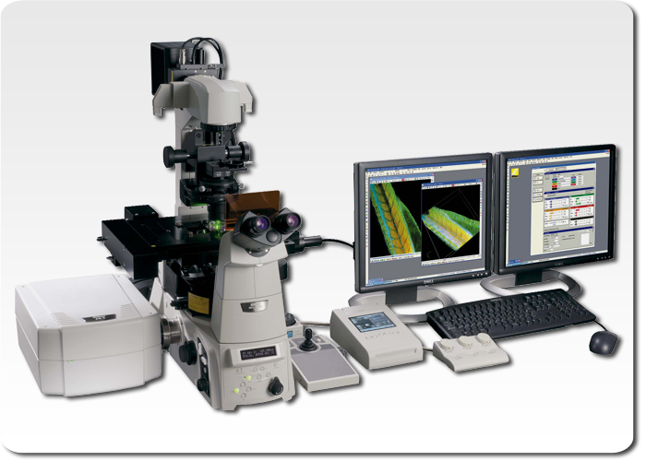
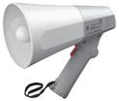
Engineering Controls
All collecting optics (e.g. lenses, telescopes, microscopes, etc) that integrate the use of lasers or laser systems shall have a feature that would maintain the laser radiation transmitted through the collecting optics to levels at or below the applicable MPE. The feature may be one of the following:
Interlocks
Filters
Attenuators
In Class 3B and 4 laser installations area warning devices are required. These devices warn people with a visual or audible alarm that the laser beam is on prior entering the area

Slide 24
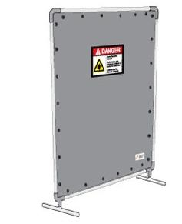
Engineering Controls – Protective Housing
Protective Housing: Shall be provided for all classes of lasers and laser systems. Protective housing may require interlocks
Operating a class 3B or 4 laser without protective housing may be necessary in research areas and during services. In these cases control measures must be instituted which may include:
Creation of a laser control area
Eye protection
Appropriate barriers
Administrative and procedural controls
Education and training
Protective Housing
Barrier

Slide 25
Engineering Controls – Beam Path
Beam path control for Class 3B and 4 lasers and laser systems shall be accomplished as follows:
For an unenclosed beam path the Laser Safety Officer (LSO) shall perform a hazard analysis that will depend on the:
Environment
Geometry of the application
Spatial limitation of other hazards associated with the laser use
For a limited beam path (i.e. the beam path is confined by design to limit the accessibility to the open beam) the Laser Safety Officer (LSO) shall perform a hazard analysis.
Class 1 condition: If the hazard analysis determines that procedural controls can provide adequate protection, the laser system is effectively rendered a Class 1 laser
For an entirely enclosed beam path where the enclosure fulfills all requirements of protective housing, the requirements for the “Class 1 condition” are fulfilled and no further controls are required

Slide 26
Administrative Controls
Administrative or procedural controls are methods or instructions that specify rules and/or work practices in order to minimize the potential hazard associated with laser use
ANSI (American National Standards Institute) and the Labor Rule 50 of the New York State proved guides and regulations for lasers used in research, such as:
Selecting a Laser Safety Officer (LSO) for the given institution who is responsible for overseeing the laser safety program
Developing standard operating procedures (SOP) and policies
Creating laser safety education and training for laser users
Developing an authorized user list. Only authorized personnel are allowed to operate and maintain the lasers and laser system

Slide 27






Administrative Controls
Regulatory agencies may ask who the Laser Safety Officer (LSO) is at your campus. The LSOs for the Mount Sinai Health System are listed below:
Dr. Jacob Kamen
Chief LSO
Arthur Tortorelli
LSO of New York Eye and Ear Infirmary
Dr. Barbara Zeifer LSO of Beth Israel Hospital
Ellen Silber Roosevelt Hospital
Dave Augustine
LSO of Mount Sinai Queens
TBD
LSO of Brooklyn Hospital

Slide 28
Personal Protective Equipment
When other control measure are not practical, personal protective equipment (PPE) shall be used to provide protection against laser radiation
Laser protective equipment (LPE) shall be used for Class 3B and 4 laser systems
LPE may include :
Goggles
Face shields
Spectacles
Prescription eyewear with absorbent filters
LPE shall be specifically selected to withstand either direct or diffuse exposure to the laser radiation

Slide 29
Personal Protective Equipment
LPE shall be clearly labeled with the wavelength and optical density (OD) for which protection is afforded
Optical Density (OD) refers to the degree of laser transmission through the LPE
OD = 1, means 10% of the beam will pass through the LPE
OD = 2, means 1% of the beam will pass through the LPE
OD = 3, means 0.1% of the beam will pass through the LPE
…etc
Periodic inspection of LPE shall be routinely performed. The inspection includes
LPE cleaning protocol
Attenuation inspection
Frame integrity inspection
Light leak inspection
The LPE inspection protocol shall be described in the departmental laser safety policy
The LPE inspection records must be maintained

Slide 30
Personal Protective Equipment
Skin protection can be achieved through engineering controls. In some cases a lab coat may fulfill this protection requirement
Tightly-woven flame-retardant fabrics provide the best protection for Class 4 laser use
Most gloves will provide some protection against scattered laser radiation
Special care shall be taken when using UV lasers. Special shields and clothing that attenuate the UV exposure to levels below the applicable MPE is needed
NOTE: Chronic exposure to UV laser radiation may have long term adverse effects which are not fully understood at this time

Slide 31
Alignment Procedure
The following requirements must be met during alignment procedures for Class 3B and 4 laser systems:
Perform alignment in such a way that the primary beam, along with specular and/or diffuse reflections, do not expose the eye to a level above the MPE
All service personnel must have the appropriate laser education and safety training
The person performing the alignment must be trained to perform alignment
A written alignment SOP shall be developed and approved by the LSO
Substitute the laser for a low-power visible laser for alignment if possible

Slide 32
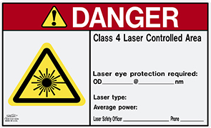
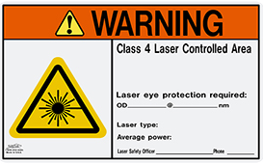
Laser Signs
DANGER signs indicate an imminently hazardous situation that, if not avoided, will result in death or serious injury
WARNING signs indicate an imminently hazardous situation that, if not avoided, could result in death or serious injury

Slide 33
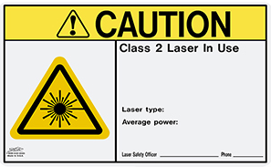

Laser Signs
CAUTION signs indicate a potentially hazardous situation that, if not avoided, could result in a minor injury
NOTICE signs indicate the presence of a laser, it is used to addresses practices not related to personal injury

Slide 34

Medical Examinations
Medical examinations shall be performed within 48 hours following a suspected or actual laser-induced injury
Information regarding the wavelength, exposure and emission characteristics shall be given to assure an appropriate medical referral
Pre-exposure medical surveillance for users of Class 3B and 4 laser systems is no longer required

Slide 35
Non-Beam Hazard

Slide 36
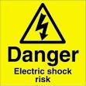
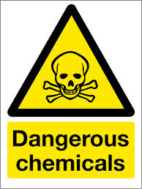
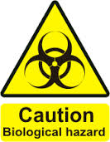
What Are Non-Beam Hazards
Non-beam hazards are a class of hazards that do not result from direct human exposure to a laser beam. Non-beam hazards include physical, chemical, and biological agents and may be generated when a material is exposed to a laser beam. [ANSI Z136.1-7.1]

Slide 37
Electrical Hazards
Electric shock can occur from contact with energized electrical conductors contained within a device that operates at a potential of 50 volts or above
Resistive heating can occur during current flow through a conductor
Equipment malfunctions can lead to the ignition of flammable materials and cause electrical fires

Slide 38
Electrical Hazards
Additional electrical safety requirements are imposed upon laser devices, systems and those who work with them by the US Department of Labor, Occupational Safety and Health Administration (OSHA), National Electrical Code (NFPA-70), and related state and local laws and regulations. These requirements must be observed with all laser installations
Potential electrical problems in laser installations may include:
Uncovered and improperly insulated electrical terminals
Hidden ”Power-Up” warning lights
Lack of personnel trained in current cardiopulmonary resuscitation practices, or lack of refresher trainings
Safety measures not being practiced during maintenance and service
Failure to properly discharge and ground capacitors
Non earth-grounded or improperly grounded laser equipment
Non-adherence to the OSHA lock-out standards [29 CRF 1910.147]
Excessive wires and cables on floor that create a fall or slip hazard

Slide 39
Other Hazards
Collateral radiation is produced by system components such as the power supply, discharge lamp and plasma tubes. Plasma radiation is generated when an energetic laser beam interacts with matter, typically metals
Fire Hazard: Class 4 laser beams represent a fire hazard. Exposure of class 4 laser beam can result in potential fire hazard. Where flammable compounds or substances exist it is possible that fires can be initiated by class 3B lasers
Explosion Hazards: High pressure arc lamps, filament lamps and capacitor banks in laser equipment shall be enclosed in housing which can withstand explosive pressure resulting from component disintegration

Slide 40
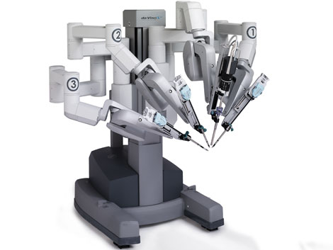
Mechanical and Noise Hazards
Mechanical Hazards Associated with Robotics. Robots can punch holes in protective housing and damage the beam delivery system
Noise control may be necessary in some lasers
Robotic Surgeon

Slide 41
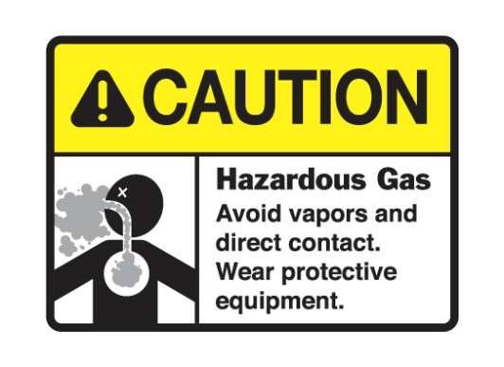
Chemical Hazards
Laser Generated Air Contaminants (LGAC) may be generated when certain class 3B and 4 laser beams interact with matter. The quantity, composition, and chemical complexity of the LGAC depends greatly upon target material, cover gas and beam irradiance
Many hazardous gases are used in lasers and laser applications. All hazardous gases shall be contained in an approved gas cabinet that is alarmed with sensors to indicate potential leakage. SOPs must be developed for safe handling of compressed gases

Slide 42
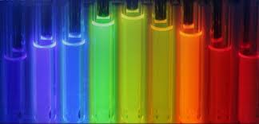
Chemical Hazards
Laser Dyes and Solvents. Some dyes are highly toxic and special care should be taken when handling them. A Material Safety Data Sheet (MSDS) for dye compounds shall be available to all appropriate workers. The use of dimethylsufoxide (DMSO) as a solvent for cyanine dyes in dye lasers should be discontinued. Dye lasers containing at least 100 mL of flammable liquids shall be in conformance with the provision of the NFPA 30 and 45, and the NEC – Article 500 – Hazardous Locations
Laser Dyes

Slide 43
Chemical Hazards
There are 3 major control measures available to reduce the concentration of chemical agents to acceptable levels
Exhaust ventilation concentration of LGAC should be maintained at or below the allowable levels specified by OSHA
Respiratory protection may be used to control brief exposures
Isolation of the process by physical barriers

Slide 44
Bioeffects of Laser Radiation

Slide 45
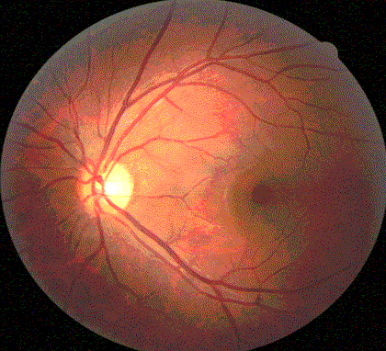
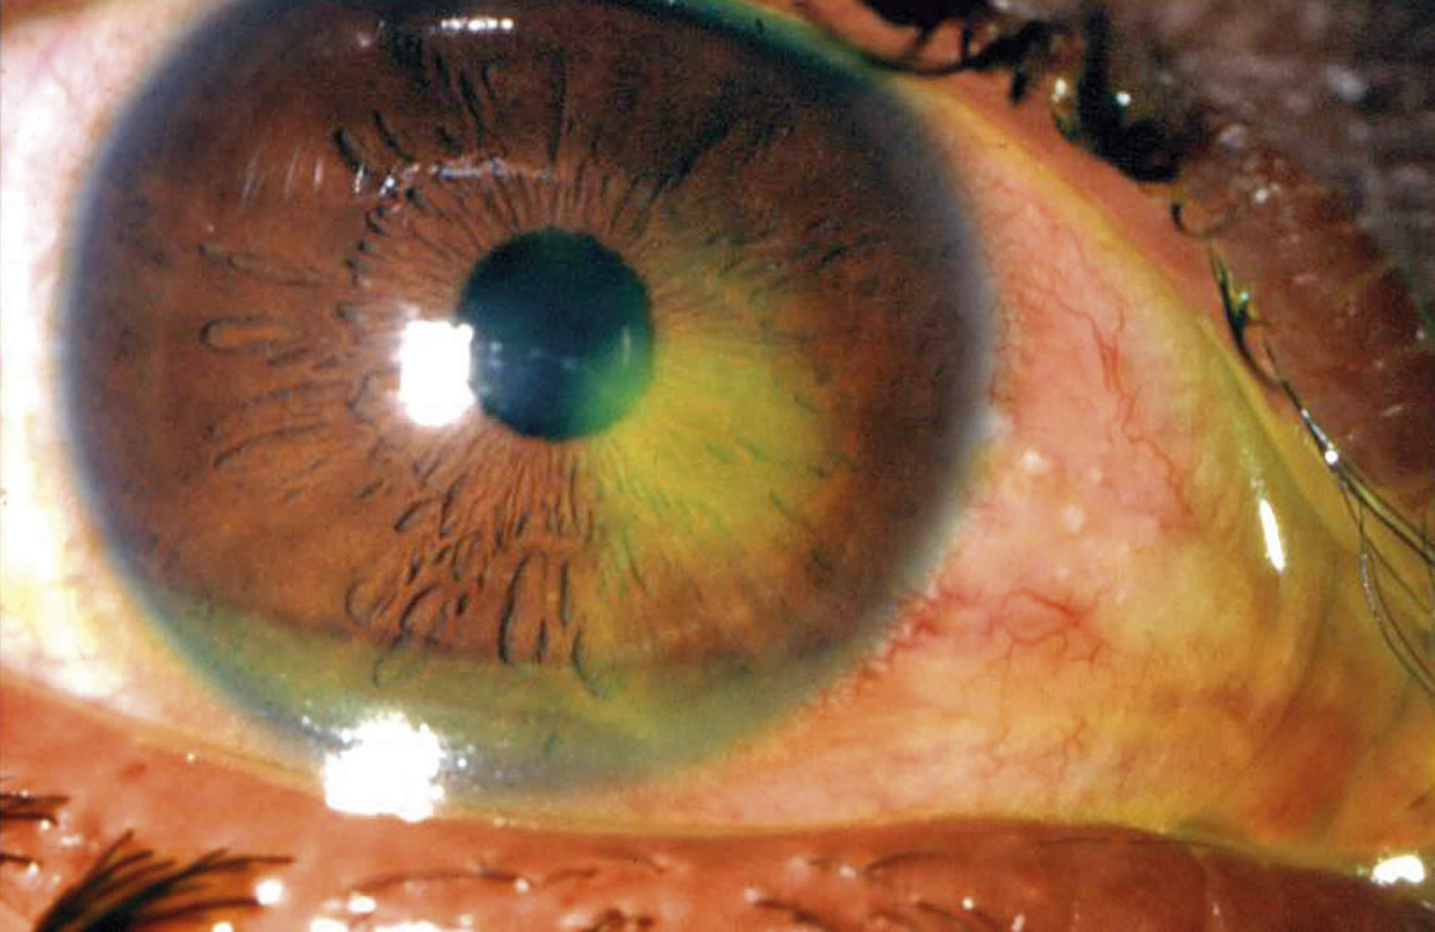
Bioeffects of the Eye
The unprotected human eye is extremely sensitive to laser radiation and can be permanently damaged from direct or reflected beams. Due to tissue characteristics, the area of the eye damaged by laser energy is dependent upon the wavelength of the incident laser beam. The retina, cornea, and lens are the areas most commonly damaged
Visible and near infrared (400 – 1400 nanometers) laser light pose a critical hazard to the retina. These wavelengths are also know as the “retinal hazard region”
Ultraviolet (180 nm – 400 nm) laser light can cause photochemical damage if it is absorbed by selectively sensitive portions of cells in the cornea. Excessive exposure to UV light can cause photophobia, redness of the eye, tearing, discharge, and stromal haze

Slide 46
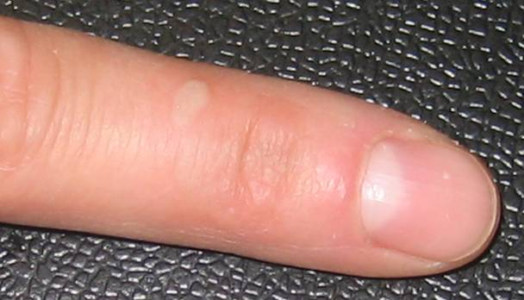
Bioeffects of the Skin
Thermal (burn) injury is the most common cause of laser induced skin damage. Thermal damage is generally associated with lasers operating at exposure times greater than 10 microseconds and in the wavelength region from the near ultraviolet to the far infrared
The principal thermal effects of laser exposure depend on:
The absorption and scattering coefficients of the tissues at the laser wavelength
Irradiance or radiant exposure of the laser beam
Duration of the exposure and pulse repetition characteristics, where applicable
Extent of the local vascular flow
Size of the area irradiated

Slide 47
Injuries and Accidents Associated with Laser Operation

Slide 48
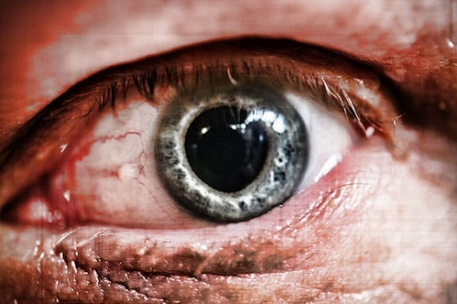
Accidents Associated with Lasers
Accidents associated with laser operation can occur for a variety of reasons, including :
Unanticipated eye exposure during alignment
Misaligned optics and upwardly directed beams
Available eye protection not used
Equipment malfunctioning
Improper methods of handling of high voltage
Intentional exposure of unprotected personnel
Operators unfamiliar with laser equipment

Slide 49

Accidents Associated with Lasers
Lack of protection against non-beam hazards
Improper restoration of equipment following service
Eyewear worn inappropriately for laser use
Unanticipated eye/skin exposure during laser usage
Inhalation of laser generated air contaminants or viewing laser generated plasmas
Fire resulting from the ignition of materials
Eye or skin injury of photochemical origin
Failure to follow standard operating procedures (SOPs)

Slide 50
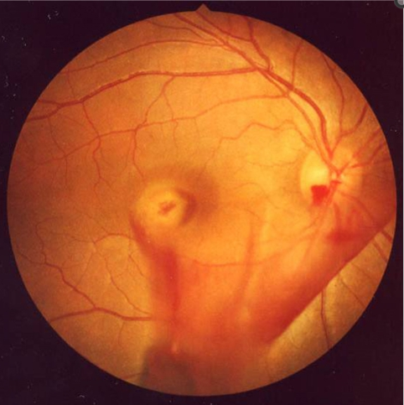
Injury Case I
In 2002, a 23-year-old female was accidentally exposed to a Q-switched Nd:YAG laser operating at 1064 nm
The laser fired inadvertently while the patient was adjusting target without the use of her protective goggles
Immediately after the exposure, she experienced a bright flash of light followed by a sudden loss of vision in her right eye
Fundoscopic photograph on the day of injury revealed vitreous hemorrhage and the site of laser injury at the macula

Slide 51
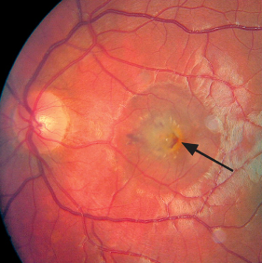
Injury Case II
In 2010, a 15-year-old boy ordered a high powered laser pointer on the Internet to use as a toy for popping balloons
He accidentally shined the laser into a mirror and the laser beam hit his eyes
He noticed immediate blurred vision in both of his eyes. He waited 2 weeks before seeking an ophthalmic assessment, when he could no longer disguise his bad vision
Photograph of the fundus of the eye shows central subretinal hemorrhage (arrow) and retinal edema, suggesting a break in Bruch's membrane caused by a disruptive laser burn

Slide 52
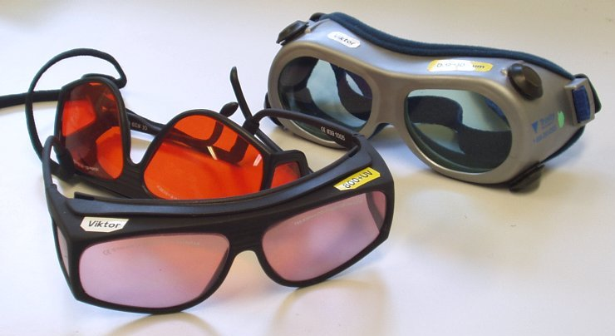
Injury Case III
In 1983, While observing diffuse reflected light on other mirrors during alignment of optical components, the user turned to talk to another employee and was struck in the eye by a beam
The user was not wearing eyewear appropriate for the spectrum which he was being exposed, and the beams were not appropriately enclosed

Slide 53
Summary

Slide 54
Things to Remember
Always use appropriate goggles during alignment or when using an open beam source
Never override the interlocks of protective housing
Use proper laser safety signs when operating a laser
Be aware of other hazards associated with laser operation, such as fire, electrical, etc
Know you Laser Safety Officer

Slide 55
Now for the Quiz…
You have just finished reviewing the material for this course
Click the right facing arrow in the top right corner of the slide to proceed to the quiz

